Slide 1
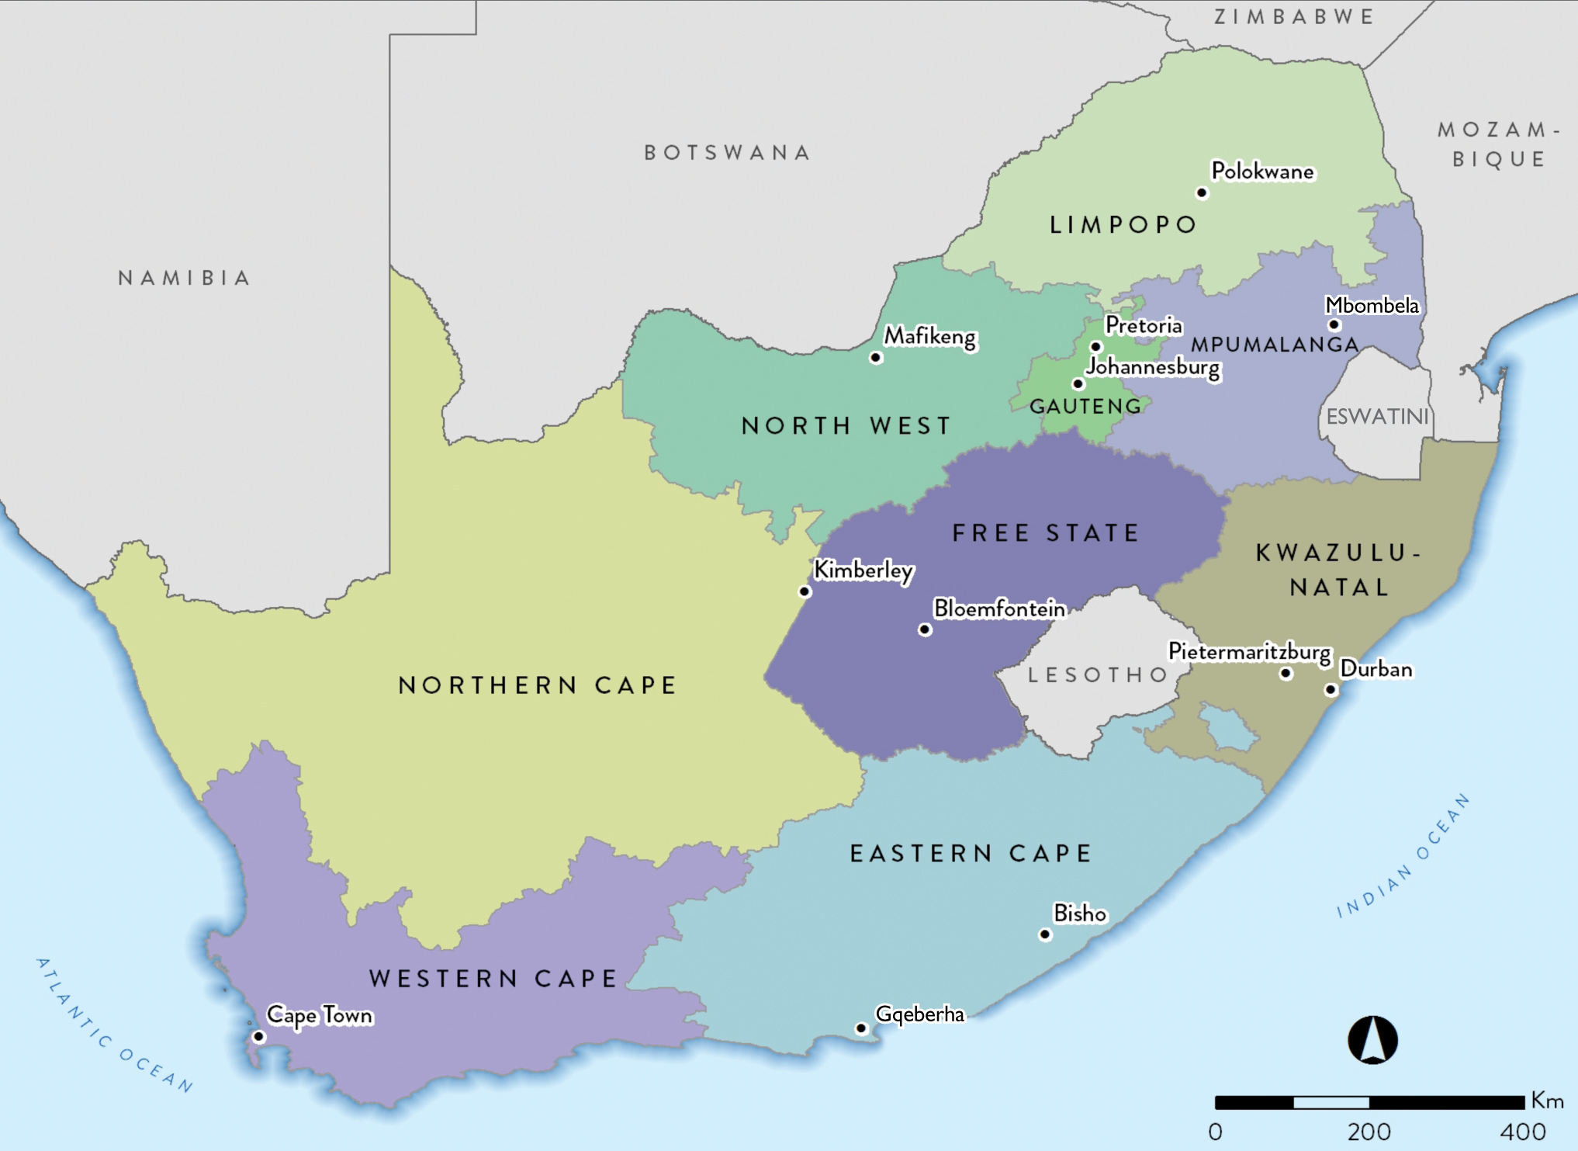
61.29 million
Notes:
Based on Stats SA’s mid-year population estimates

Slide 2
Population data by ethnic group
Population group | Million | %
Black | 49. 70 | 81.1
Coloured (mixed ancestry) | 5.40 | 8.8
Indian/Asian | 1.57 | 2.6
White | 4.62 | 7.5
Total | 61.29 | 100
Notes:
Stats SA’s 2023 mid-year estimates:
https://www.statssa.gov.za/publications/StatsInBrief/StatsInBrief2023.pdf
*Note exclusion of “Other” category

Slide 3
Population data by province
Province | Million | %
Eastern Cape | 6.67 | 10.88
Free State | 2.94 | 4.79
Gauteng | 16.39 | 26.75
KwaZulu-Natal | 11.62 | 18.96
Limpopo | 5.99 | 9.78
Mpumalanga | 4.77 | 7.78
North West | 4.22 | 6.89
Northern Cape | 1.35 | 2.20
Western Cape | 7.34 | 11.98
Total | 61.29 | 100.0
Notes:
See scaling factor comment

Slide 4
Number of treatment centres by province and sector
Sector | EC | FS | GT | KZ | LP | MP | NW | NC | WC | All
Public | 3 | 6 | 7 | 5 | 1 | 0 | 3 | 1 | 5 | 31
Private | 20 | 11 | 78 | 66 | 17 | 10 | 14 | 5 | 32 | 253
Total | 23 | 17 | 85 | 71 | 18 | 10 | 17 | 6 | 37 | 284
Notes:
Identical to last years report

Slide 5
Prevalence (pmp) and numbers of patients on KRT by province
Province | EC | FS | GT | KZ | LP | MP | NW | NC | WC | All
Patients | 957 | 615 | 2 605 | 1 692 | 364 | 227 | 271 | 183 | 1 967 | 8 881

Slide 6
KRT prevalence (pmp) by healthcare sector
 | Public | Private
Population in millions | 52.17 | *9.13
Patients on treatment | 2 308 | 6 573
Treatment rate (pmp) | 44 | 720
*Data supplied by the Council for Medical Schemes

Slide 7
Numbers of patients by province and sector
Sector | EC | FS | GT | KZ | LP | MP | NW | NC | WC | All
Public | 264 | 288 | 424 | 231 | 60 | 11 | 40 | 69 | 921 | 2 308
Private | 693 | 327 | 2 181 | 1 461 | 304 | 216 | 231 | 114 | 1 046 | 6 573
Total | 957 | 615 | 2 605 | 1 692 | 364 | 227 | 271 | 183 | 1 967 | 8 881

Slide 8
KRT prevalence (pmp) by province and sector
Notes:
Adjusted for unclassified medical aid beneficiaries

Slide 9
Distribution of patients by treatment modality
Modality | Patients | %
Haemodialysis | 6 262 | 70.5
Peritoneal dialysis | 817 | 9.2
Transplant | 1 802 | 20.3
Notes:
Assumption of 10% attrition (for PD and HD patients only)
Transplant numbers left unchanged
0.9 X PD patients
0.9 X HD patients

Slide 10
KRT modality by sector
Public
Private
Treatment modality | Public sector |  | Private sector
 | Patients | % | Patients | %
Haemodialysis | 833 | 36.1 | 5 559 | 84.6
Peritoneal dialysis | 536 | 23.2 | 298 | 4.5
Transplant | 939 | 40.7 | 716 | 10.9
Notes:
Tx patients – no adjustments
Adjusted no of HD patients= (0.9X HD patients)
Public HD patients = (% of HD patients in public prior to attrition assumption) X (adjusted no of HD patients)
Private HD patients = (adjusted no of HD patients) - (public HD patients)
Same logic applied for PD patients
Proportions of patients in each sector by modality
Denominators
Public = 2309
Private = 6572

Slide 11
KRT patient numbers and prevalence by ethnicity
Prevalence per million population

Slide 12
Most commonly reported causes of kidney failure
 | % of total
Hypertensive kidney disease | 38.7
Cause unknown | 31.7
Diabetic nephropathy | 12.6
Glomerular disease | 9.7
Cystic kidney disease | 2.8
Obstruction and reflux | 1.5

